Slide 1

A brief look at the WS-* framework
Josh Howlett, JANET(UK)
TF-EMC2 Prague, September 2007.

Slide 2
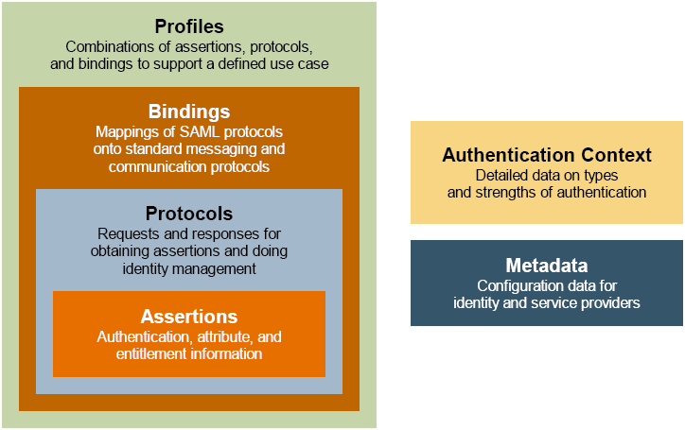
SAML 2.0 overview
A single monolithic framework: “top down”

Slide 3
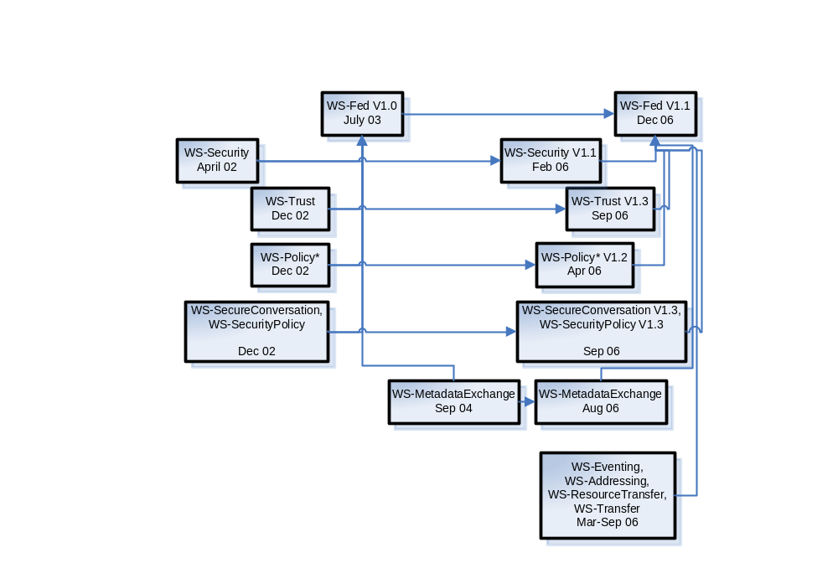
WS-* for federation overview
A composable framework: “bottom up”

Slide 4
Relevant WS-* specifications
WS-Security
  OASIS standard
  Defines mechanisms to construct security protocols.
    How to sign, validate and encrypt messages.
    How to bind security tokens to SOAP messages.
  Intended to be sufficiently flexible to use a variety of security models and tokens
    PKI, Kerberos, TLS, etc.

Slide 5
Relevant WS-* specifications
WS-Trust
  Defines protocols to issue, renew and cancel WS-Security tokens.
  WS-Trust is agnostic with to the type of token.
    To WS-Trust, a SAML assertion is just another kind of token.
  A requestor acquires a token issued by a security token service (STS), and can present it to a web service.
  A requestor learns of a web service’s or STS’ security policy through WS-Policy.
  An STS may in turn require some token from another STS for issuing its own tokens; this permits brokering between different trust domains.

Slide 6
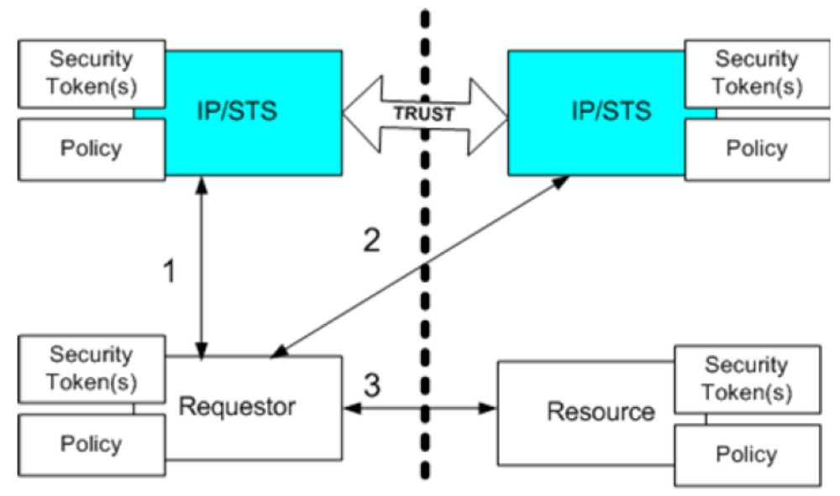
Relevant WS-* specifications
Simple trust brokering across a trust boundary using WS-Trust

Slide 7
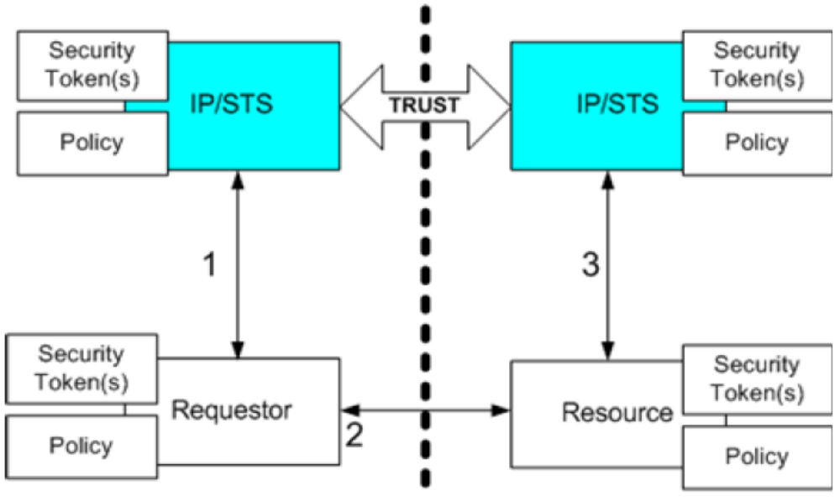
Relevant WS-* specifications
Authorisation of token performed by an authorisation service using WS-Trust

Slide 8
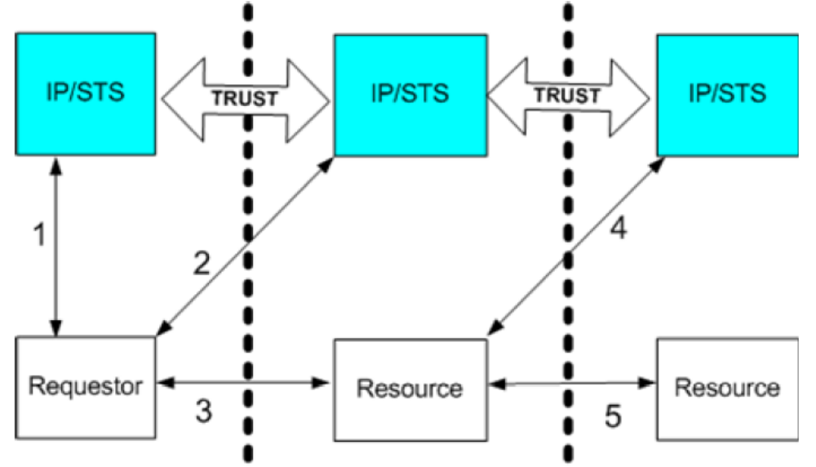
Relevant WS-* specifications
Constrained delegation using WS-Trust

Slide 9
Relevant WS-* specifications
WS-Federation
  Similarities to SAML 2.0
    Metadata
      Analogous to SAML 2.0 Metadata; perhaps a bit richer?
    Sign-Out
      Similar to SAML 2.0 Single logout
    Pseudonym management
      Analogous to SAML 2.0 Name Identifier Management & Name Identifier Mapping
    Authentication types
      Analogous to SAML 2.0 “Authentication context”; less rich.

Slide 10
Relevant WS-* specifications
WS-Federation
  Differences to SAML 2.0
    No equivalent SAML 2.0 Web SSO Profile
      WS-Federation operation analogous to SAML 2.0 ECP.
      “Active requestor” versus “Passive requestor” (browser)
      WS-Federation Passive Requestor Profile defines “front-channel” bindings.
    No equivalent SAML 2.0 Attribute Profile
      But WS-Security defines SAML,X509,Kerberos,… tokens
    No equivalent SAML 2.0 Assertion Query/Request Profile
      It’s all WS-Trust security token request/response, irrespective of the type or the purpose of token.

Slide 11
Relevant WS-* specifications
WS-Federation
  The Good
    WS-Federation encompasses identity and web service federation within a single comprehensive framework.
  The Bad
    WS-Federation mimics the SAML 2.0 profiles while failing to profile the interesting use-cases, such as constrained delegation, that it hints at.
    SAML 2.0 has years of experience behind it
      WS-* maturity varies significantly from spec to spec
      WS-Federation is particularly hard to understand and contains numerous errors and inconsistencies.

Slide 12
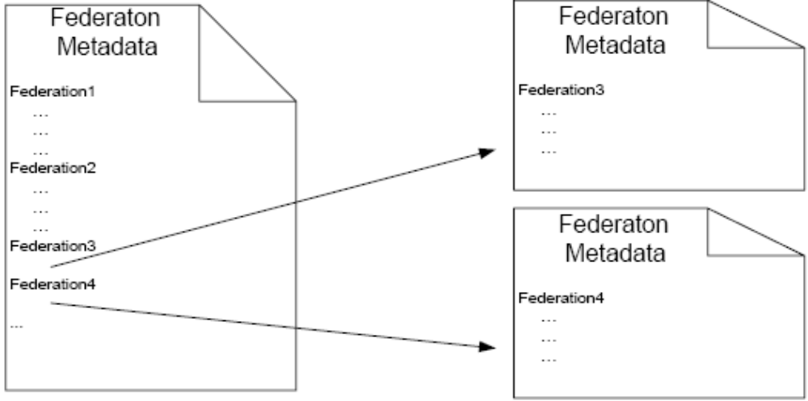
Spot the typo!

Slide 13
Relevant WS-* specifications
WS-Federation
  The Ugly
    WS-Trust fails to address some requirements of federation (ie. privacy) and so WS-Federation has to retrospectively extend WS-Trust
    SAML 2.0 defines a common request/response protocol model
      WS-Federation relies on a variety of dissimilar protocols: WS-Trust (tokens), WS-Transfer & WS-ResourceTransfer (metadata, pseudonym operations), WS-Metadata-Exchange, etc.
    SAML 2.0 defines common bindings to transport
      WS-Federation Passive Requestor: defines protocol-specific bindings & a strong preference for front-channel.

Slide 14
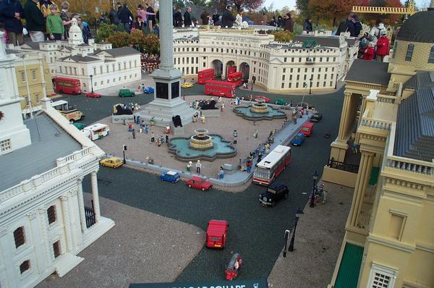

Slide 15


Slide 16
Does WS-* matter?
Yes
  It’s backed by Microsoft and IBM
  It tries hard to be a comprehensive framework
No
  It is too complex
  It is too immature
  Interoperability will be difficult
  It doesn’t appear to solve anything that SAML 2.0 and ID-WSF can’t already do
In conclusion
  I want to like it…
  …but it is not fully baked and it is late to the party
  Its best chance of survival is in the SME space

Slide 17
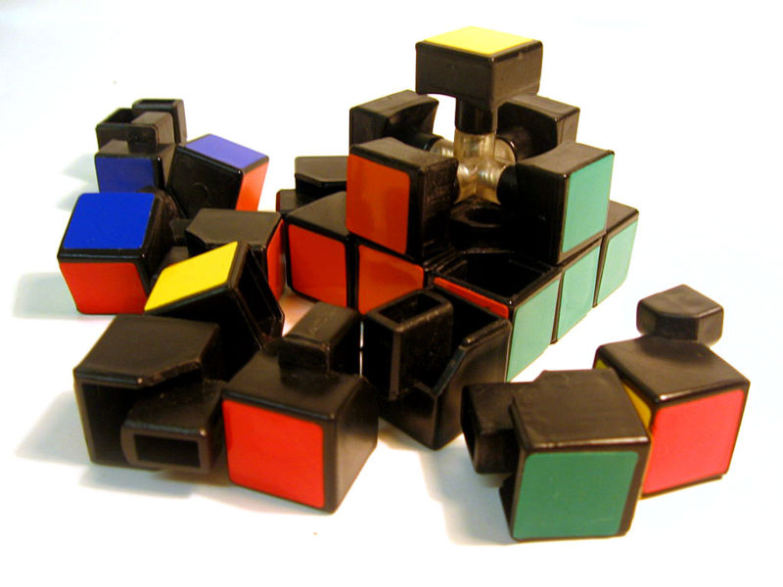
Thank you for your attention
No questions please, I’ve
exhausted my knowledge ☺

